Slide 1
Agenda
Build a Scalable AI-Driven Chat Application Using Azure & React
Challenges Enterprises Face Today
Solution: Intelligent Chat Platform
What is RAG?
How RAG Work?
Real-World Use Cases
Building ScholarHat Chat App
ScholarHat AI Chat App Components
RAG Architecture on Azure
ScholarHat AI Chat App in Action
Q&A

Slide 2

About Mentor
👑 Founder & CEO of ScholarHat – a leading EdTech platform
🎤 A Speaker, Solution Architect and Mentor
🏆 10x Microsoft MVP (2016–2025)
👨‍🏫 Corporate Trainer for top MNCs: IBM, Cognizant, Dell & more
🌍 Trained 100,000+ professionals worldwide
📚 Author of 45+ Technical Interview Q&A eBooks
🎓 Mentor of 27+ Courses in programming, cloud, web & AI
📝 Author of 1,000+ Articles in programming, web, cloud, & AI
🚀 Empowering AI-Ready Tech Careers & Leadership

Slide 3
Challenges Enterprises Face Today
🔁 Repetitive questions – Agents answer the same FAQs 60% of the time, wasting hours daily.
🧠 Scattered knowledge – Information is in emails, PDFs, CRMs, databases, and wikis with no central place to find it.
🐌 Slow responses – Customers wait hours or days for basic answers, leading to frustration and anger.
🚫 Inconsistent answers – The same question gets different replies across chat, email, and phone, breaking customer trust.
⚠️ No smart scaling – More customers mean hiring more agents.
Notes:
Let’s start with a fact: Over 70% of enterprise data is unstructured – Its in emails, PDFs, support tickets or wikis. Yet most companies still force users to navigate siloed portals or wait for email replies. Meanwhile, every department builds its own chatbot, none of which talk to each other or to backend systems. The result? Slow answers, frustrated customers, and massive operational cost. Today, I’ll show you how to solve this – not with another point solution – but with a scalable, secure AI chat platform built on Azure OpenAI and React, ready for production in weeks, not years.”

Slide 4



Solution: Intelligent Chat Platform
A production-ready AI chat application that combines the power of Azure OpenAI Service with modern web technologies to deliver intelligent, context-aware customer interactions at scale.
RAG-Powered Q&A
GPT Reasoning
Enterprise APIs
Retrieves accurate answers from your business documents and knowledge base.
Handles complex public queries with intelligent, human-like responses.
Integrates securely with your existing CRM and business workflow systems.
Notes:
Business Q&A via RAG
Public knowledge (GPT reasoning)
Real-time customer support

Slide 5
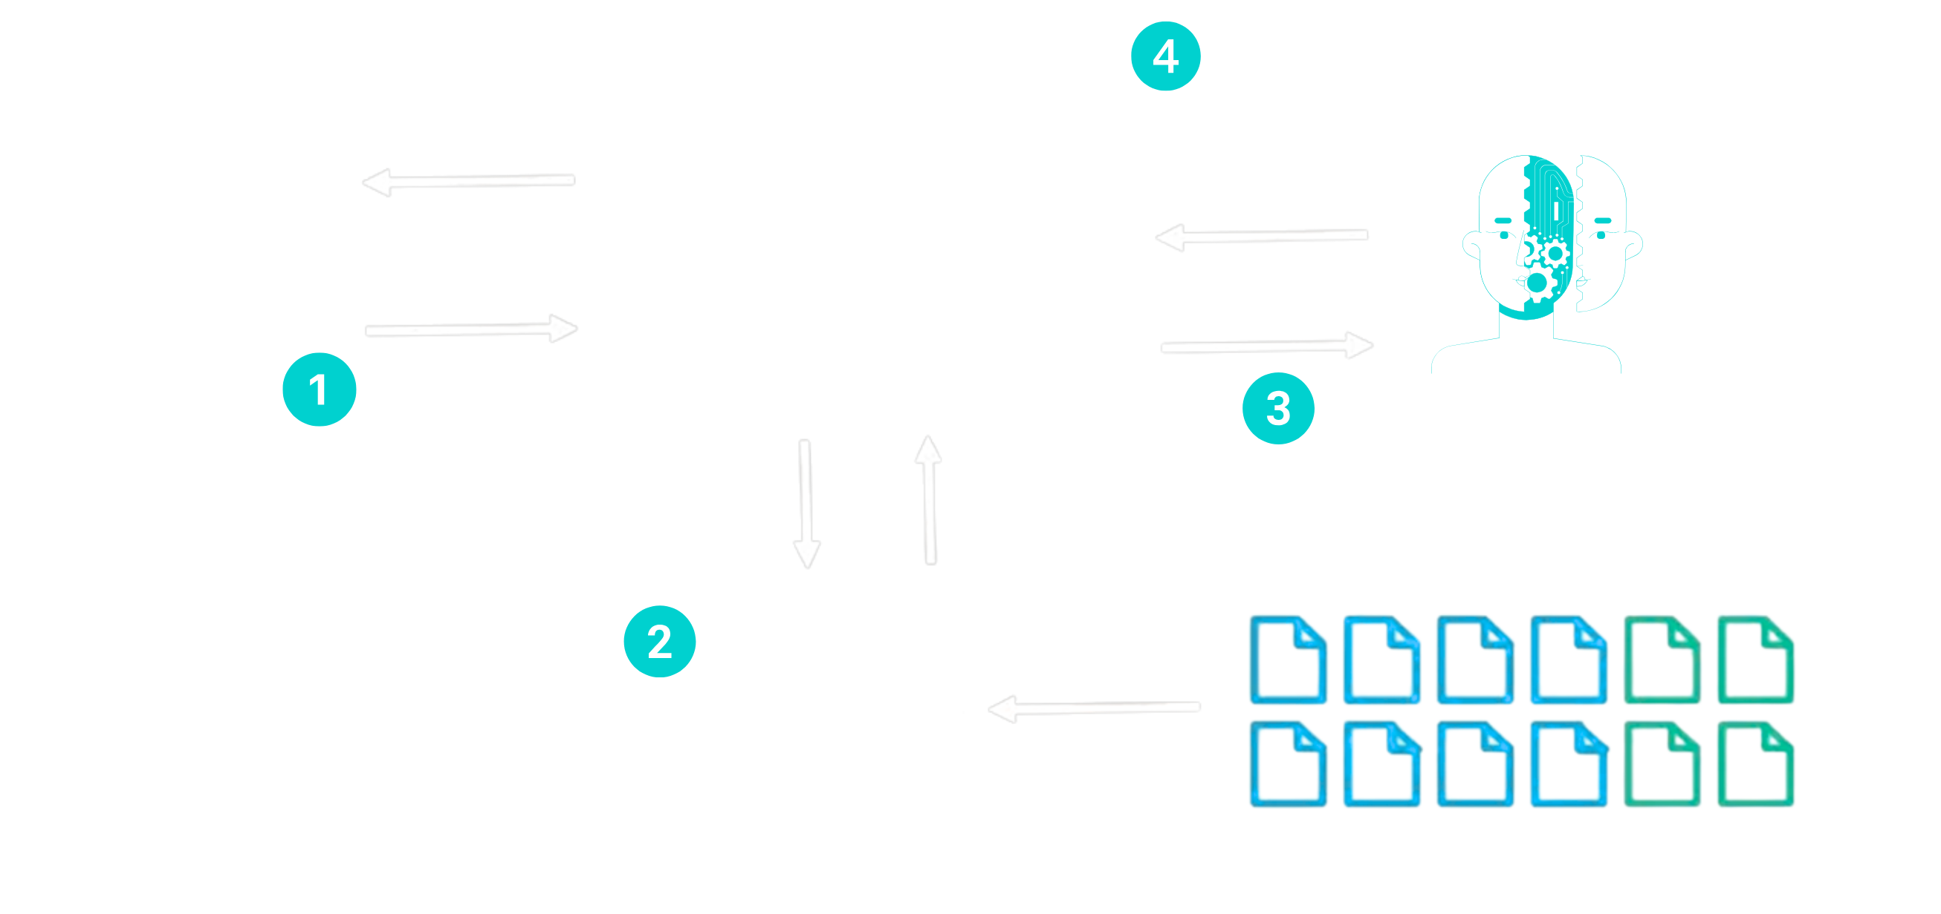
RAG = Retrieval + Context + Generation
An AI pattern that bring your data into the LLM at runtime to generate accurate, context-aware response.
🔍 Retrieval System : Semantic search over knowledge base (vector DB)
🧠 Context Injection : Add retrieved data into prompt
🤖 Generation Model (LLM) : Produces grounded, accurate answer
Notes:
Let’s understand one of the most important AI patterns today — RAG
RAG stands for Retrieval, Context, and Generation.
Grounded: The answer is based on real data provided to the LLM, not just its internal knowledge.
Diagram Flow: “If you look at the flow below:
The user sends a question
The system performs semantic search on the vector database
Relevant content (text chunks, not the vectors) is added to the prompt
The LLM generates the response
And we return the final answer to the user”
“One common misconception is that RAG returns vectors — but that’s not true.
Vectors are only used for matching. The system actually returns relevant text chunks, not vectors.”
Data Preparation (Offline)
“Before runtime, all documents are:
Split into smaller chunks and Converted into embeddings (vectors)
Stored in a vector database along with original text
So every chunk has:
Text
Vector representation
Metadata
Step 2 – Query Processing
“When a user asks a question:
The query is also converted into an embedding
Then we perform similarity search against stored vectors”

Slide 6
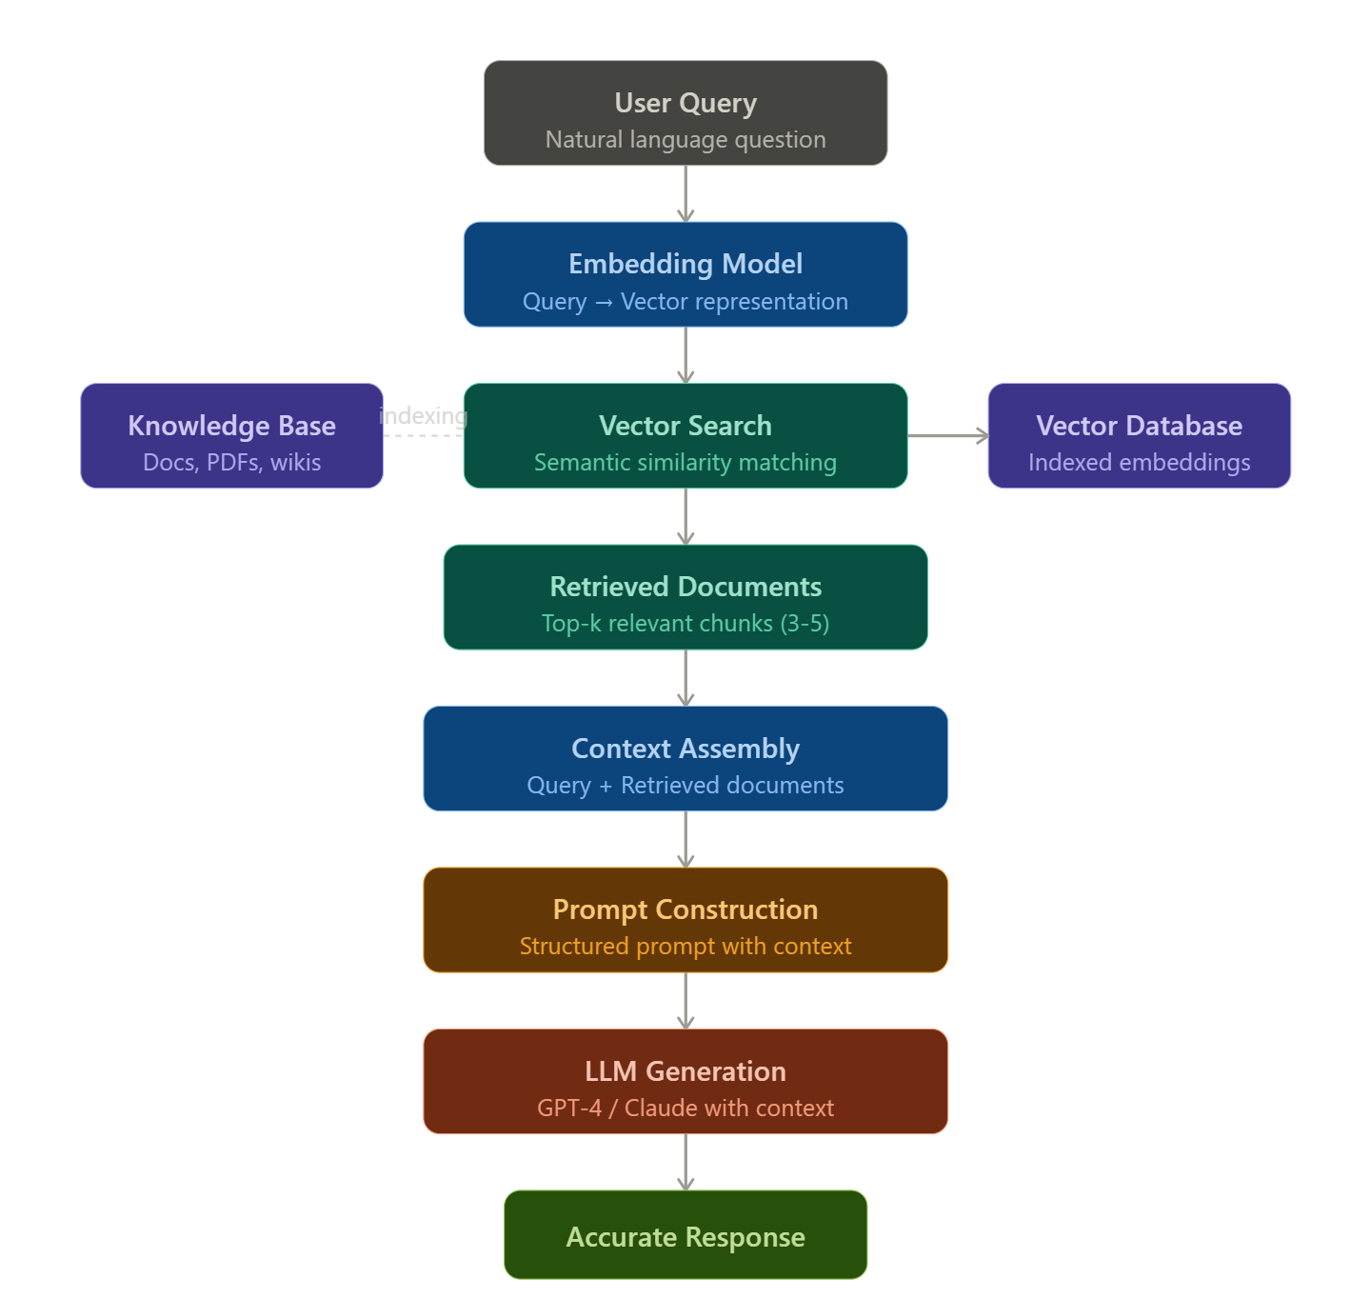
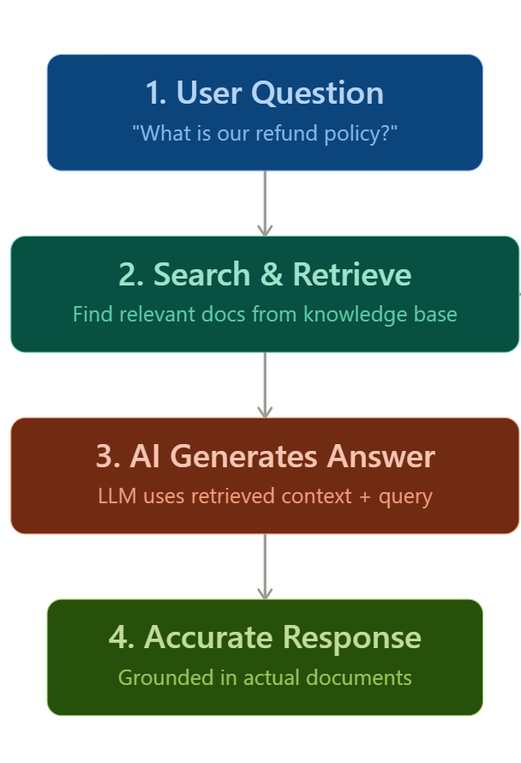
How RAG Work?
Notes:
How to choose chunk size (Important)
Chunk Size
100–300 tokens Precise Q&A
300–700 tokens Balanced (recommended) ✅ Best default
800–1500 tokens Large docs Less precise retrieval
Azure AI Search do Character-based chunking (NOT token-based)
Chunk size: ~1000–1500 characters (approx range)
Text Embedding Model doesn’t support chunk size controlling

Slide 7
Real-World Use Cases
E-commerce Product Recommendations
Intelligent product discovery based on customer preferences, order history, and real-time inventory data.
Financial Services Support
Account inquiries, transaction history, investment guidance, and secure document retrieval with full compliance.
Healthcare Patient Engagement
Appointment scheduling, symptom triage, prescription refills, and personalized health education content.
Enterprise Knowledge Management
Internal HR policies, IT troubleshooting, onboarding resources, and company documentation search for employees.

Slide 8
Building ScholarHat AI Chat App

Slide 9








ScholarHat AI Chat App Architecture
React Frontend
Backend APIs
Modern UI with real-time updates
Secure authentication & routing
Vector Database
Azure OpenAI Service
Azure AI Search for embeddings
GPT-4 or later for natural language
Data Flow: User Query → React UI → Backend API → Azure OpenAI + Vector Search → Intelligent Response

Slide 10

ScholarHat AI Chat App Components
Data Sources
Blob Storage
SQL Database
Cosmos DB
Azure AI Search
Indexing
AI Enrichment
Search Indexes
Azure OpenAI
Embedding Model
Chatbot Completion Model
Playground

Slide 11
ScholarHat AI Chat App In Action

Slide 12
What is Azure AI Search?
A dedicated, cloud-based search service for enterprise applications.
Extracts and organizes useful information from various sources like documents, databases, and web pages
Support Cognitive skills which enrich content by detecting language, entities, and sentiment
Search results become more relevant and meaningful through semantic ranking
Enables users to find insights quickly, improving decision-making & productivity

Slide 13
Azure Open AI
A cloud-based Microsoft service offering powerful AI models like GPT-5, GPT-4, GPT-3.5 and Embedding models.
Helps you in:
Create content – Marketing copy, blogs, product descriptions
Write code – Generate, fix, and complete code
Build chatbots – Smart, context-aware conversations
Search smarter – Understand intent, not just keywords
Process documents – Summarize contracts, extract insights
Brainstorm ideas – Storylines, concepts, creative thinking
Notes:
GPT5, GPT-4 & GPT-3.5: Advanced large language models (LLMs) for text.
Embeddings: For semantic search and text analysis.
Codex: Powers GitHub Copilot (specialized for code).

Slide 14
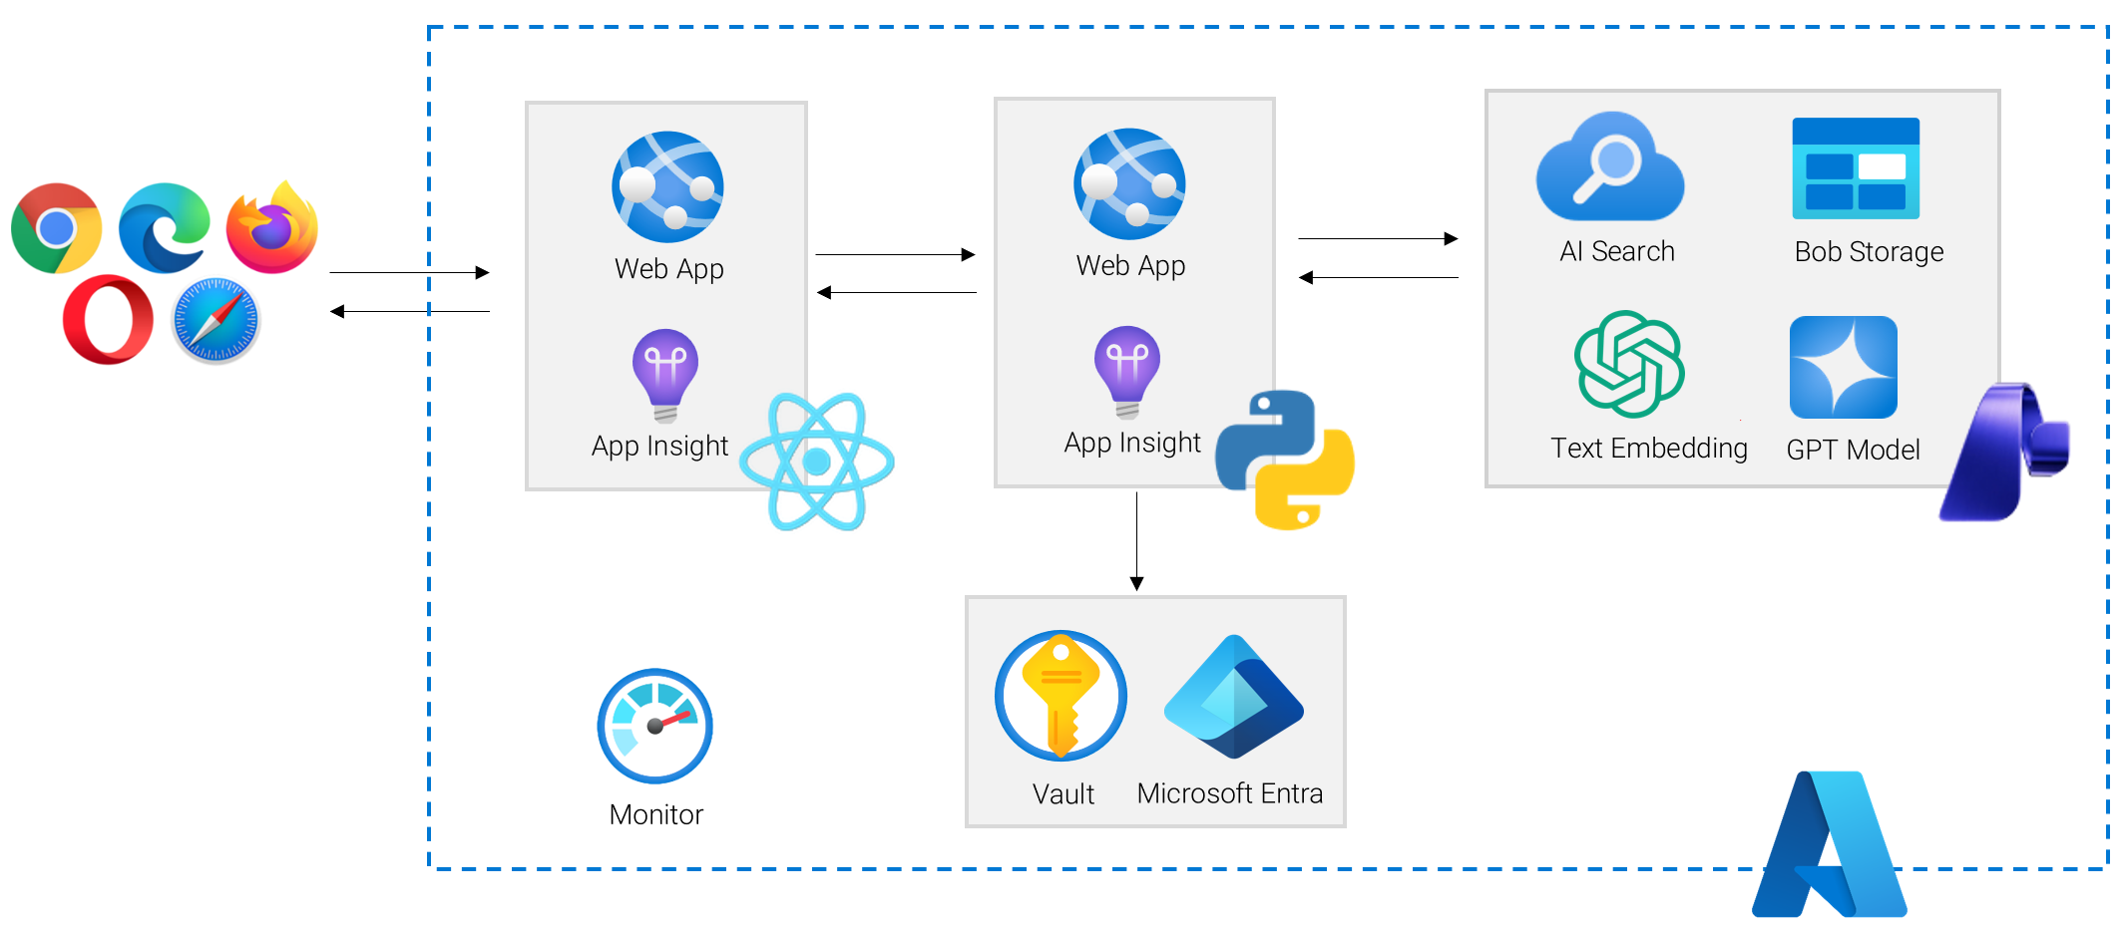
ScholarHat AI Chat App: RAG Architecture on Azure

